Slide 1


Organoid-Inspired Bio-Computer State Classification
Subtitle: Final Project - Data Science Engineering Methods (INFO6105)
• Student: Jiadong Liu
• NUID: 002506397

Slide 2
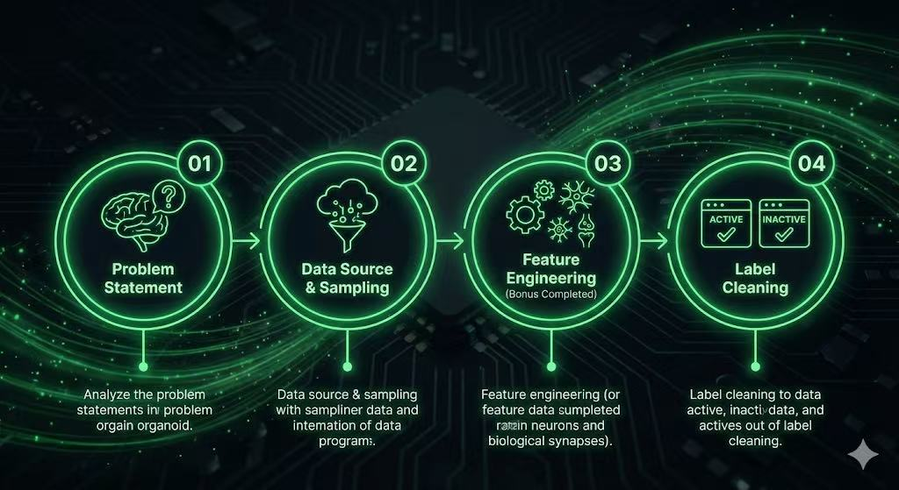

Slide 3
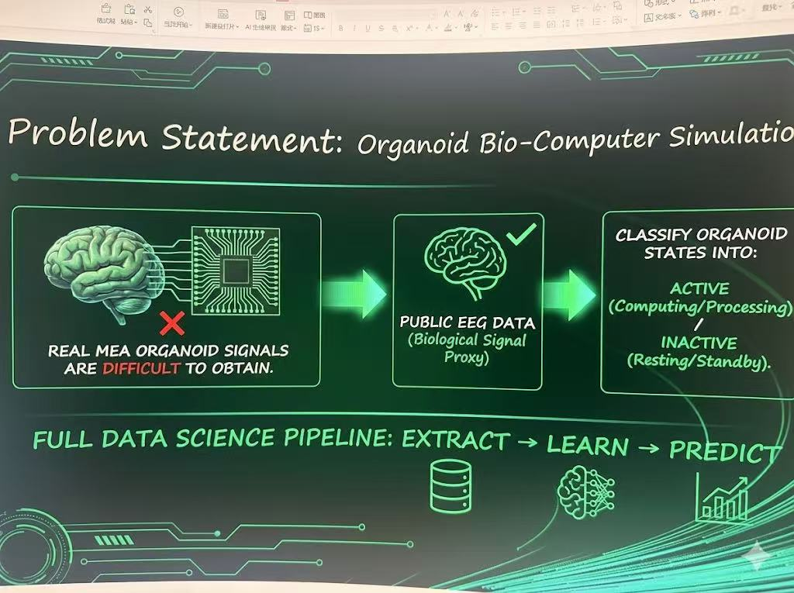
Goal: Build a predictive system that simulates the computational states of an organoid bio-computer. Real MEA (Micro-Electrode Array) organoid signals are difficult to obtain. Solution: Use public EEG data as a biological signal proxy. Task: Classify organoid states into: Active (computing / processing) Inactive (resting / standby) Follows the full data science pipeline: EXTRACT → LEARN → PREDICT
Problem Statement

Slide 4
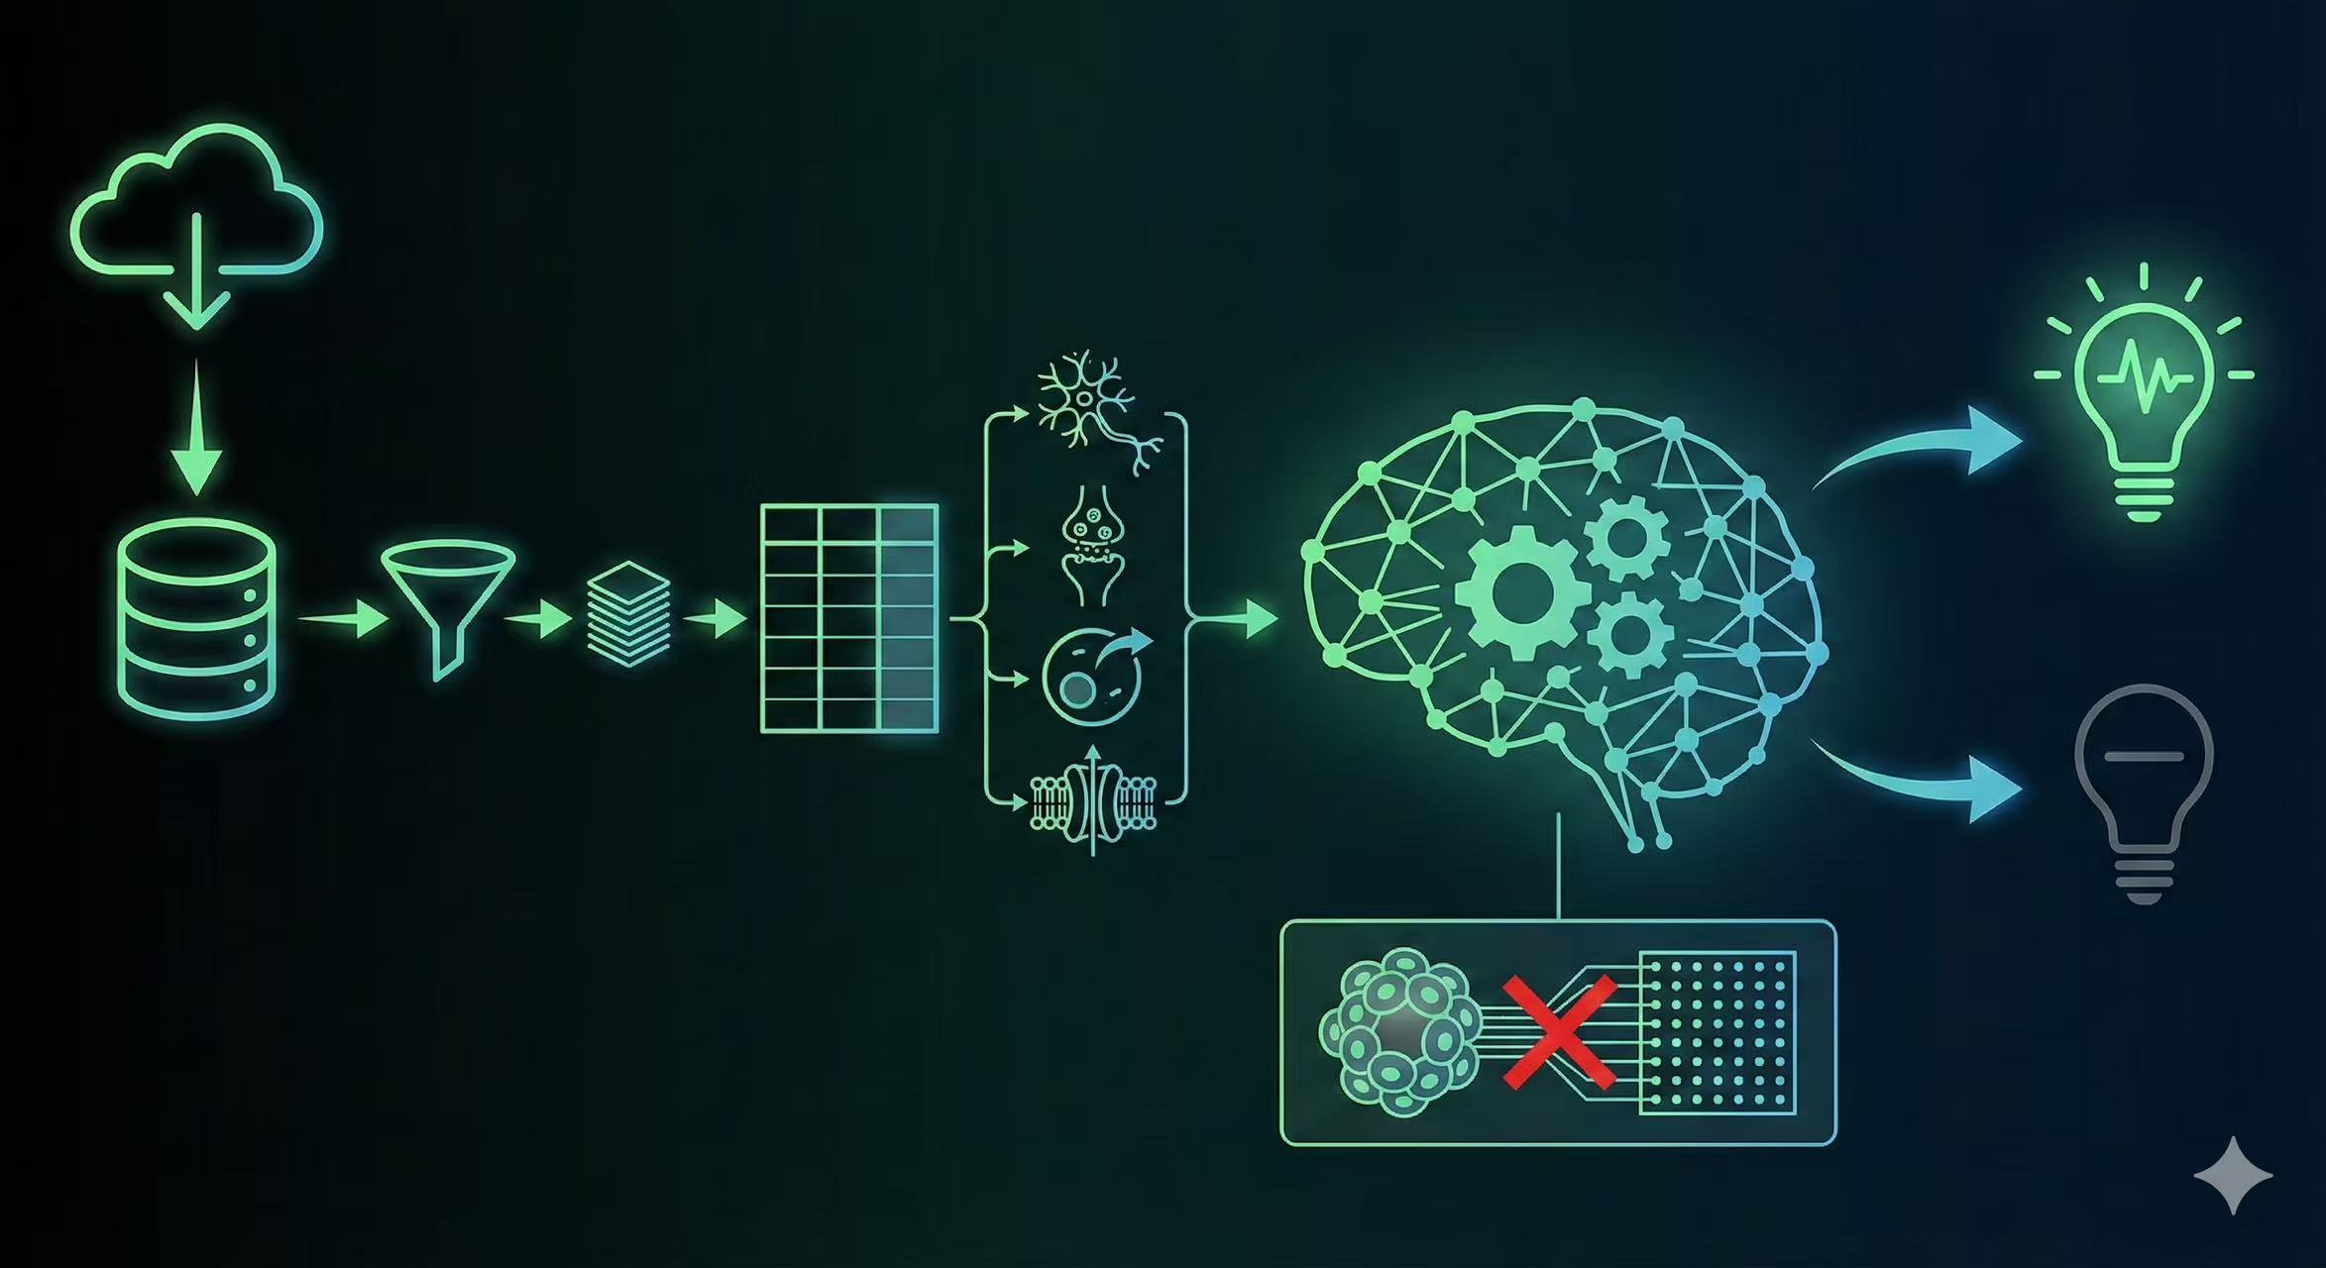
Dataset: mental-state.csv from Kaggle (Public CSV requirement met). Sampled 150 rows to meet bonus requirement: (Bonus: 100 < rows < 200) Selected 12 numerical columns + 1 target column. Renamed features into biologically-inspired names: Neuron_Input_, Synapse_Activity_, Metabolic_Rate_, Ion_Channel_Flux_, Membrane_Potential
Data Source & Sampling
This dataset provides a lightweight
biological signal proxy suitable for modeling organoid-like computational states.

Slide 5
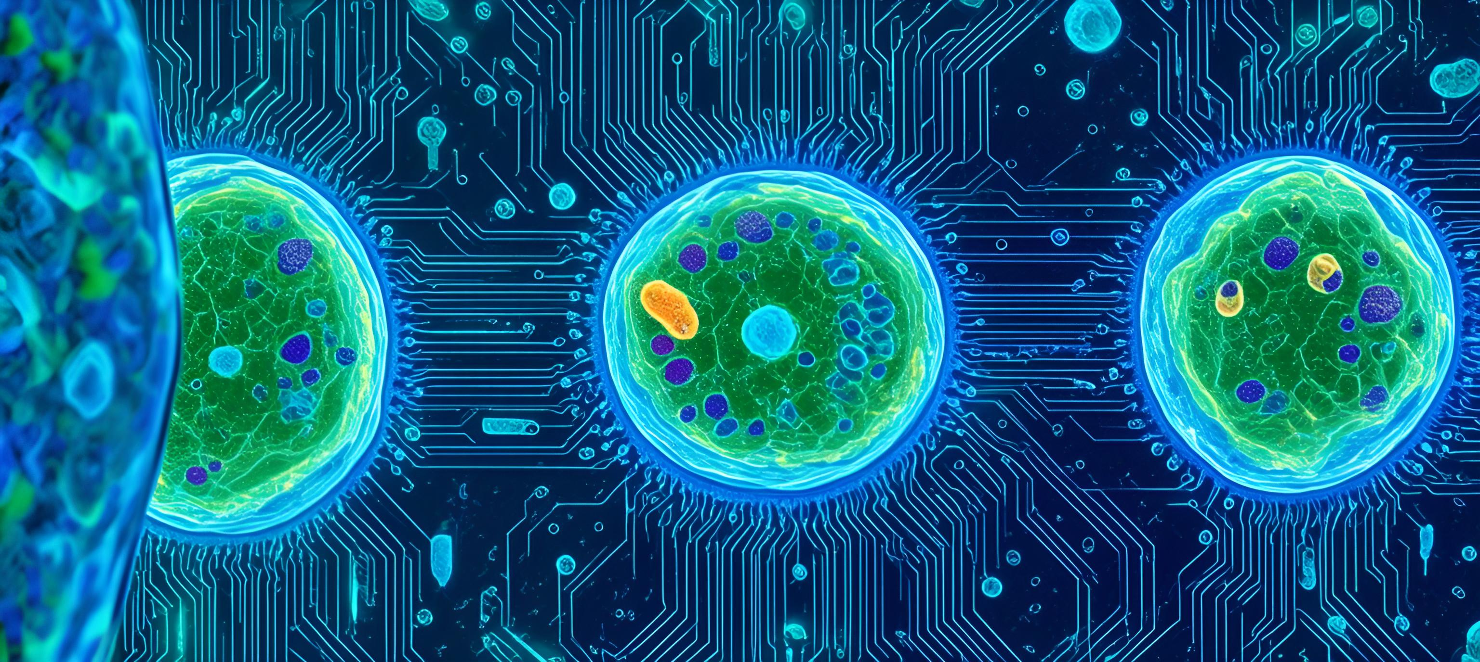



Feature Engineering (Bonus Completed)
To satisfy the “Engineer ≥ 2 features” requirement:
1. Total_Input_Power
• Sum of four neural input channels.
• Represents aggregated energy entering the organoid.
2. Synapse_Ratio
Alpha / Beta synaptic activity ratio.
Indicates network stability and excitatory balance.
➡️ Final dataset structure: 150 rows × 15 columns
(Bonus: 10 < columns < 20)

Slide 6

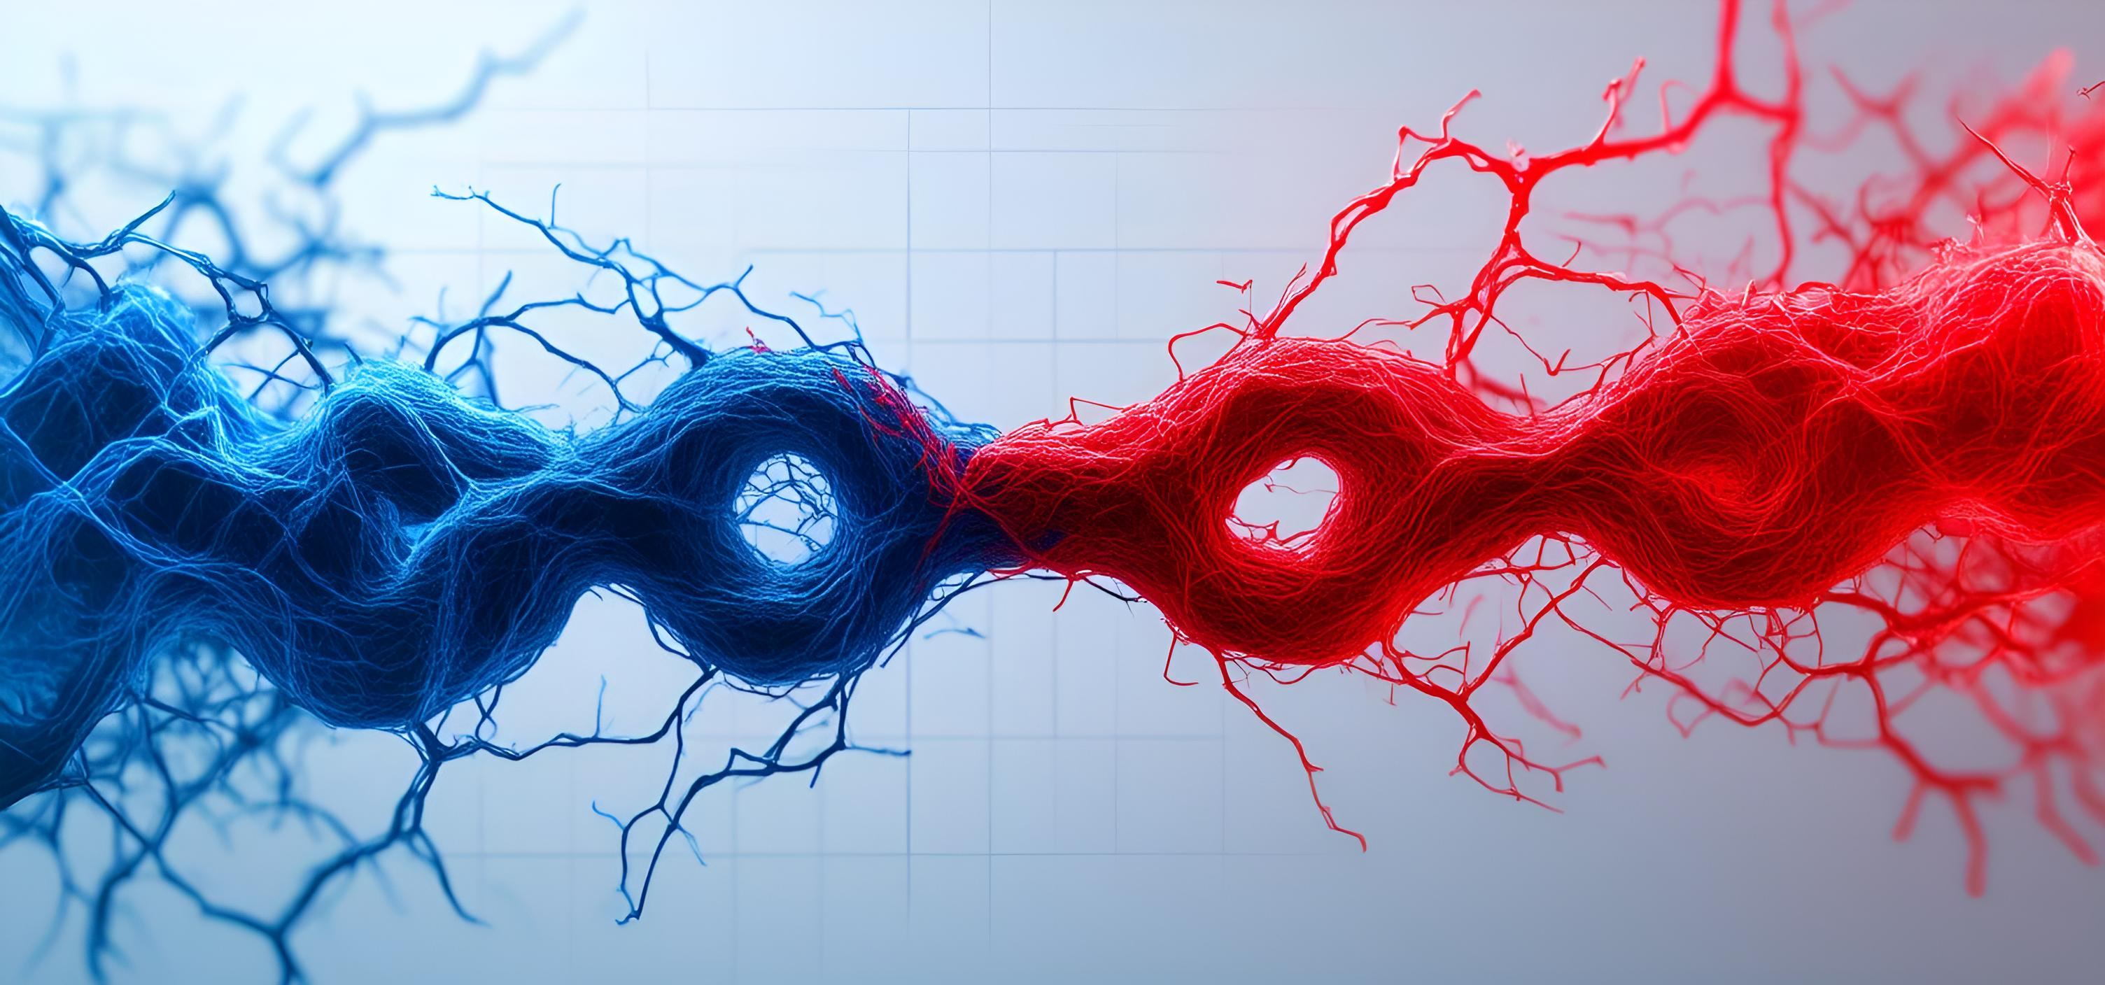
Original label inconsistent (1 / 2 or other variants). Cleaned to binary classification: 0 = Inactive 1 = Active Stored in Bio_Computer_State column.
Label Cleaning

Slide 7
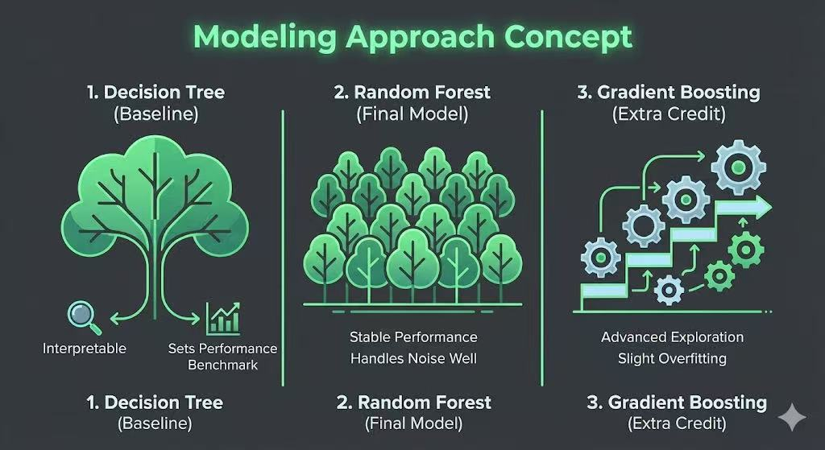

Modeling Approach
Train/Test split: 80% train / 20% test
Models implemented:
1. Decision Tree (Baseline)
Interpretable
Sets a performance benchmark
3. Gradient Boosting (Extra Credit)
2. Random Forest (Final Model)
Handles noise well
Most stable performance
Not taught in class → Additional exploration
Demonstrates ability to apply advanced models
Slight overfitting due to small dataset

Slide 8


Results
✔ Random Forest Performance (~67% accuracy)
Best stability among all models
Balanced between bias & variance
✔ Confusion Matrix Insights
Strong at detecting Active states
Some misclassification on Inactive states due to signal overlap
✔ Correlation Heatmap Findings
Strong relationships between:
Neural Inputs
Synapse Activity
Matches expected biological patterns

Slide 9


Real-Time Prediction Demo (Mini Program)
Loads saved model: my_best_model.pkl
The program initializes by loading the fully-trained Random Forest model.
This ensures that all predictions in the demo use the same learned patterns from the training phase,
making the real-time output consistent and reliable.
Accepts new “bio-signal” input
The system receives a fresh biological-style input vector,
constructed from neural-inspired features (input channels, synapse activity, metabolic rates).
Each new signal is processed instantly and fed into the model to classify the organoid’s state in real time.
To demonstrate how an organoid-inspired bio-computer could be monitored continuously,
a real-time prediction mini-program was implemented in Python.

Slide 10
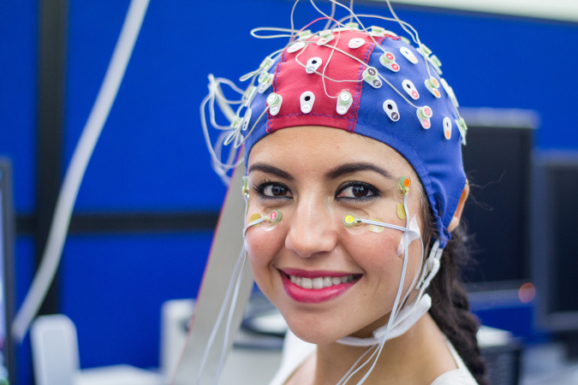



Limitations
Proxy Data
EEG is a simulation, not direct organoid recording.
01
Sample Size
N=150 limits the generalization of results.
Dynamics Modeling
02
Lacks time-series modeling for dynamic analysis.
Sorry… we’re working
on improving this!
03

Slide 11


Your model is watching you!
Great job! Everything is running perfectly.
Conclusion & Future Work

Slide 12




Pipeline
Pipeline Components
Pipeline Type
A complete end-to-end machine learning pipeline was developed, covering extraction, learning, and prediction.
The pipeline supports:
Consistent preprocessing for all models
Reproducible training and evaluation
Direct integration with the real-time demo in Python
This design aligns with industry-standard ML workflows and demonstrates full lifecycle implementation.
Includes all major stages of the project workflow:
Data Cleaning to remove inconsistencies and prepare EEG-like signals.
Feature Engineering including biologically inspired metrics (Total_Input_Power, Synapse_Ratio).
Model Training using Decision Tree, Random Forest, and Gradient Boosting.
rediction Module enabling real-time state classification of the bio-computer.
This pipeline ensures that the dataset is processed systematically from raw signals to deployable predictions.

Slide 13


Next Steps
01
02
03
Integrate Data
Implement DL
Build Dashboard
Bring real wet-lab MEA recordings into the current framework.
Use LSTM-based deep learning models to capture temporal patterns.
Create a Streamlit dashboard for real-time state visualization.

Slide 14

THANK YOU!

